Slide 1
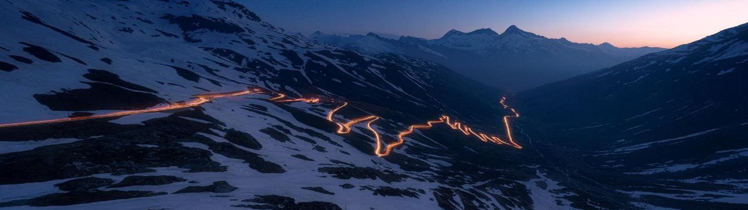
A5U – Sidepanel Blanking Die
Scrap recovery device for BL5 Cassino Cold

Slide 2
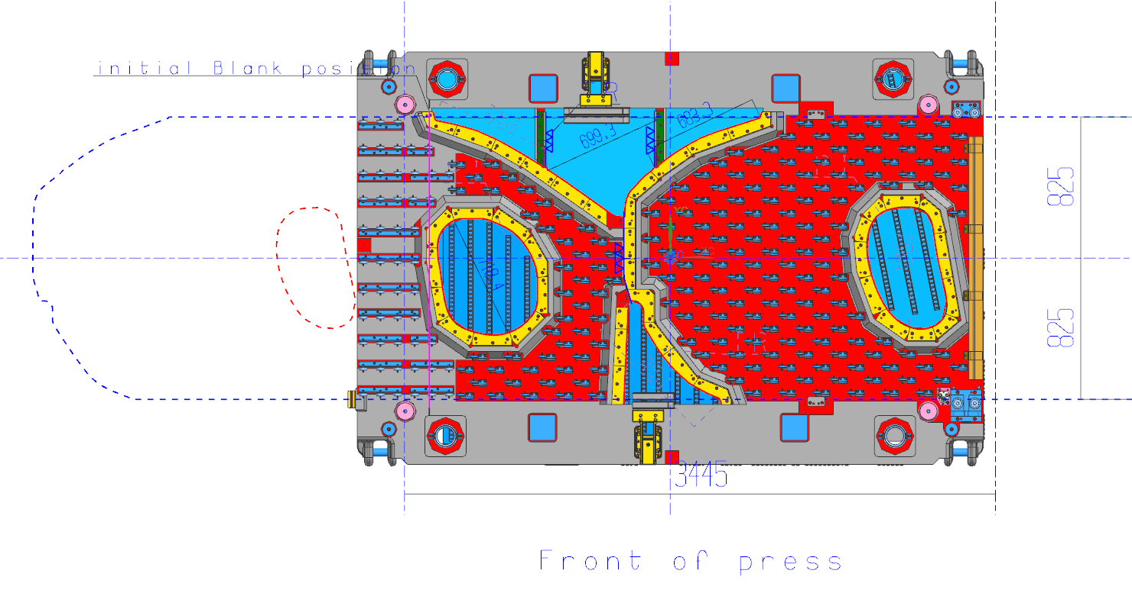
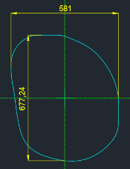
Die Layout – top view
FLOW
Direction of scrap evacuation

Slide 3
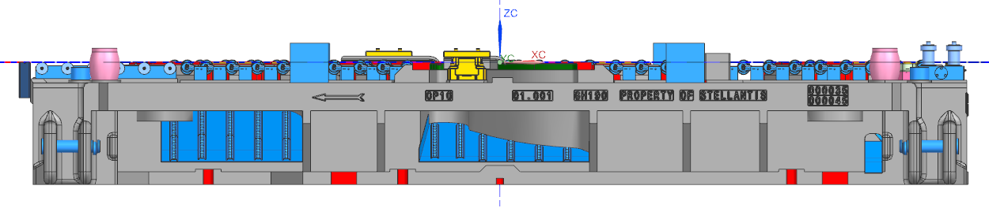
Die Layout – Side view
FLOW
Chute to evacuate the scrap
500 mm
550 mm
290 mm
Transfer height above bolster: 90 mm

Slide 4
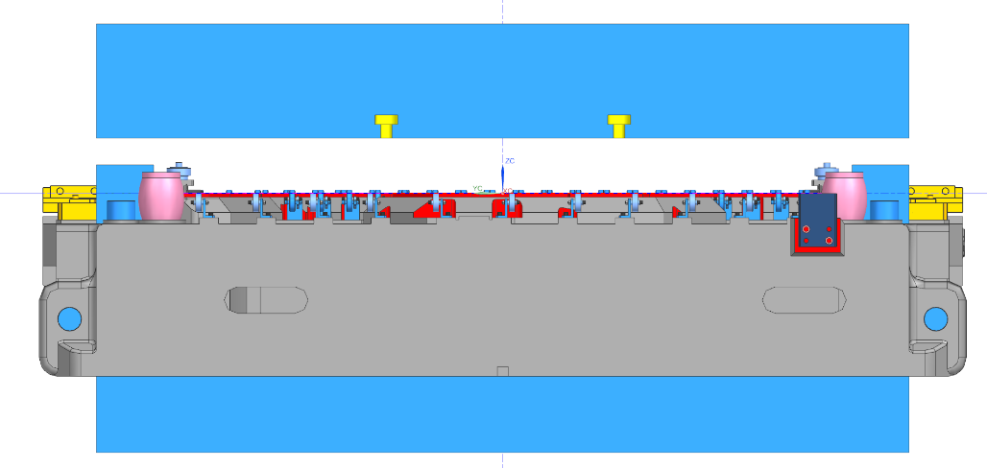
Die Layout – Side view
FLOW
Transfer height above bolster: 90 mm

Slide 5
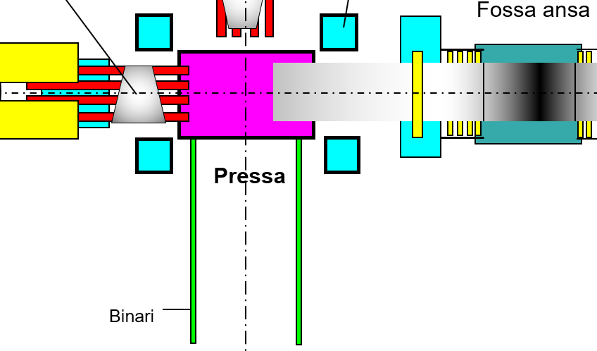
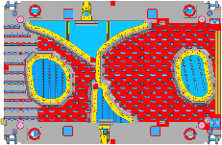
Illustration scrap recovery process
Side panel
Conveyor belts
Rotating table
This collage shows a top view of the blanking line and describes the recovery process visually.

Slide 6
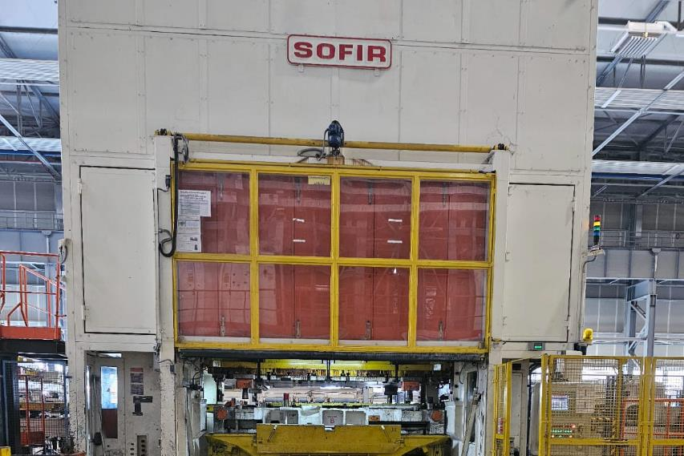
Picture of front of press -> Lifting Gate
A window must be integrated into the lifting gate through which the scrap can be evacuated to the outside.

Slide 7
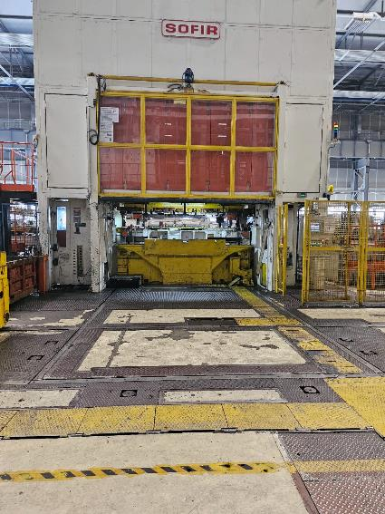
Picture of front of press -> inaccessibility with a forklift
As the area is inaccessible for forklifts during production time the scrap recovery device must be craneable.

Slide 8
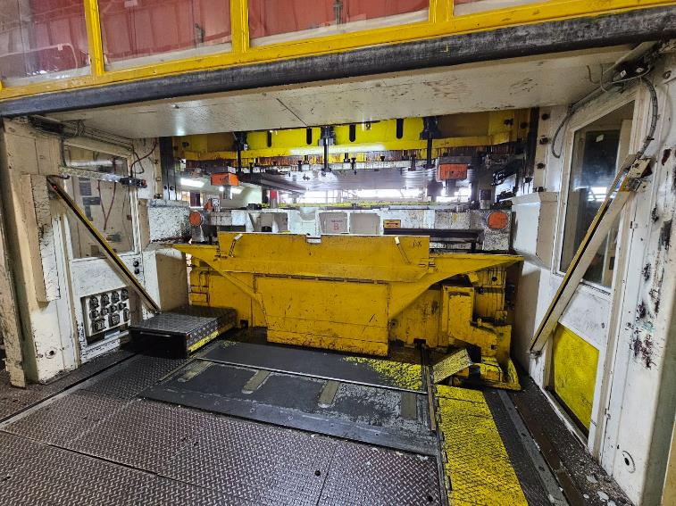
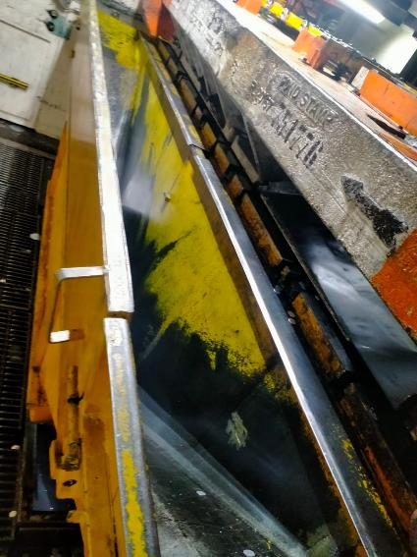
Picture of the inside of the press -> scrap chute
It is likely that the scrap chute (yellow) must be modified as the transfer height of the scrap is only 90 mm above the bolster.

Slide 9
Picture of the inside of the press -> Lightbarrier
Currently the lightbarriers are always active as the press can be operated with open lifting gate
There a 2 separate safety circuits, one secured by the lifting gate and one secured by the diagonal lightbarriers
Modification of safety controls required
(incl. Risk assessments, CE)

Slide 10
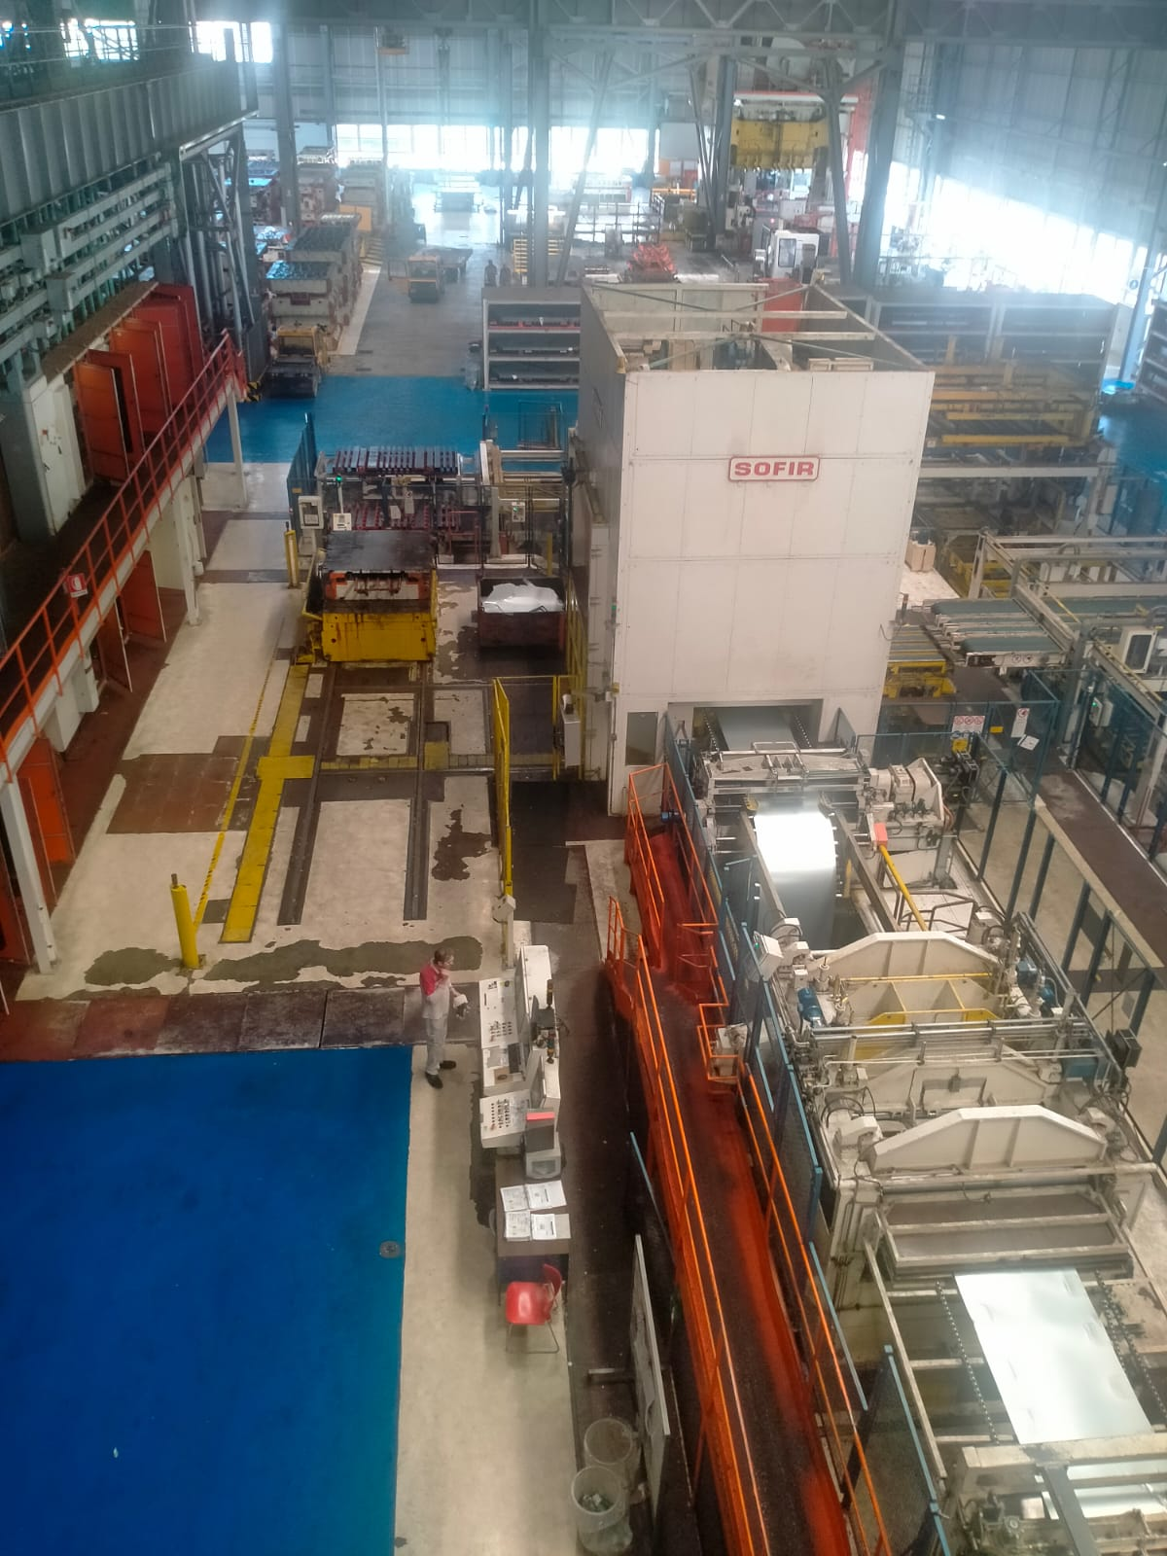
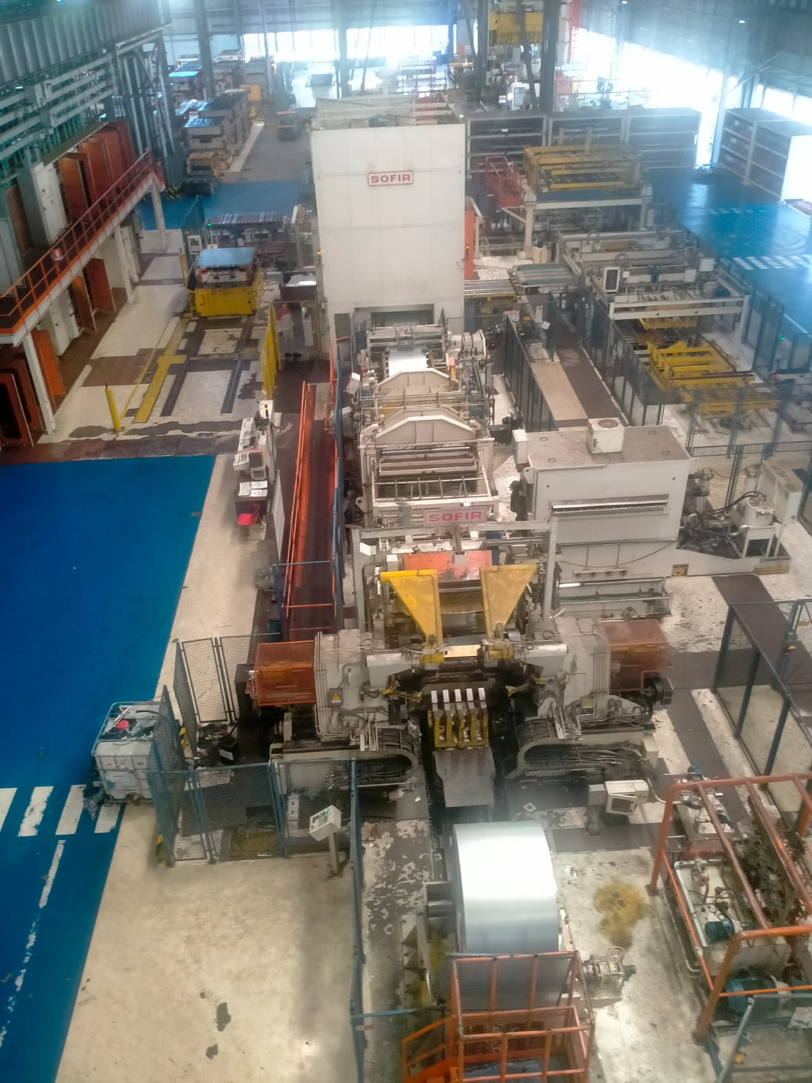
Top view of the blanking line
Limited access by forklift
Top view with indication of flow direction and direction of scrap removal
Top view of the coil storage

Slide 11
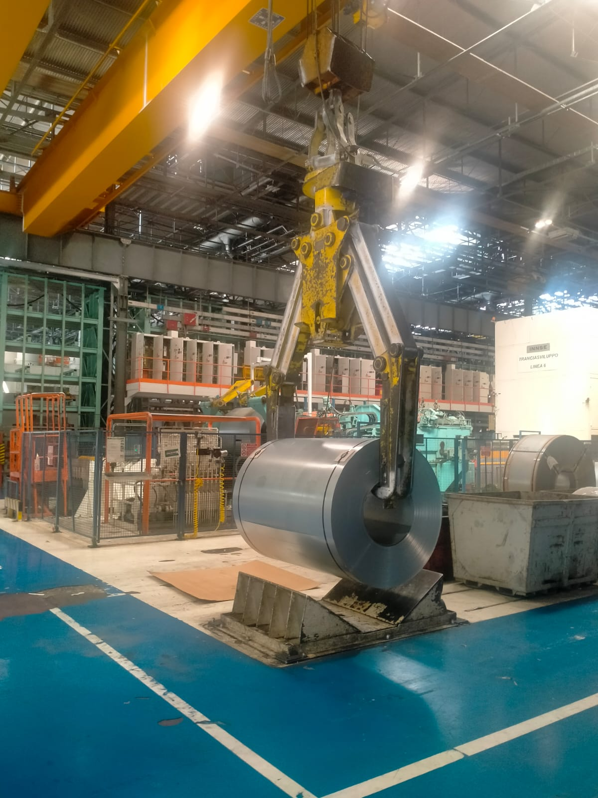
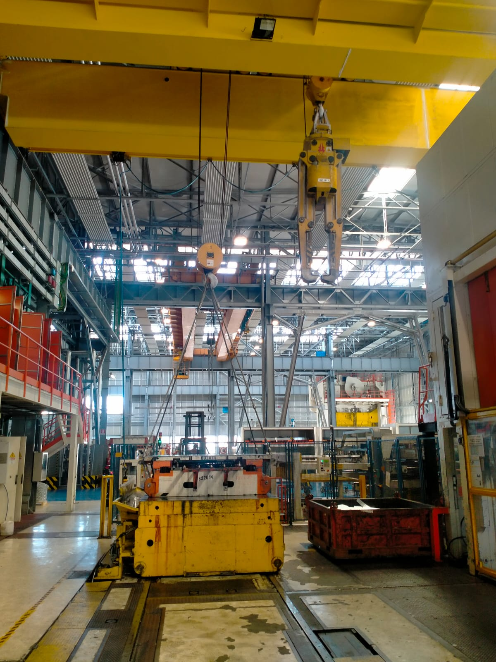
Views of the crane
Crane in action
Highest position of the coil hook next to the press
Coil hook is always attached to the big hook, small hook available for transportation of the scrap recovery device.
Highest position of the coil hook next to the press
Coil hook is always attached to the big hook, small hook available for transportation of the scrap recovery device.

Slide 12
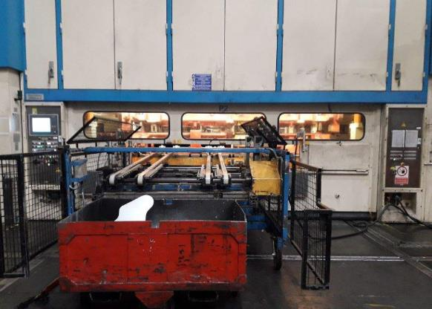
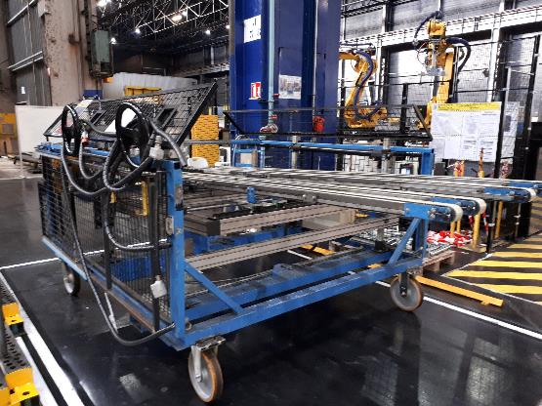
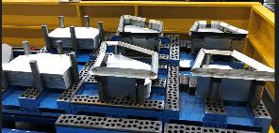
Scrap recovery device (Mulhouse)

Slide 13

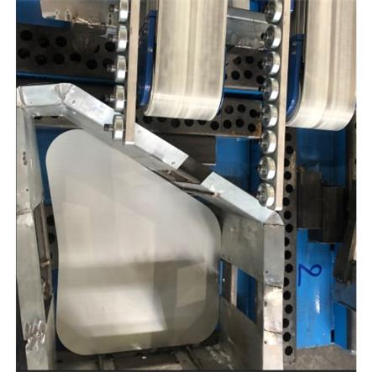
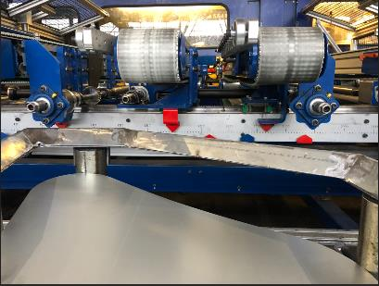
Blank pallet with blank guide (Sochaux or Mulhouse)

