Slide 1
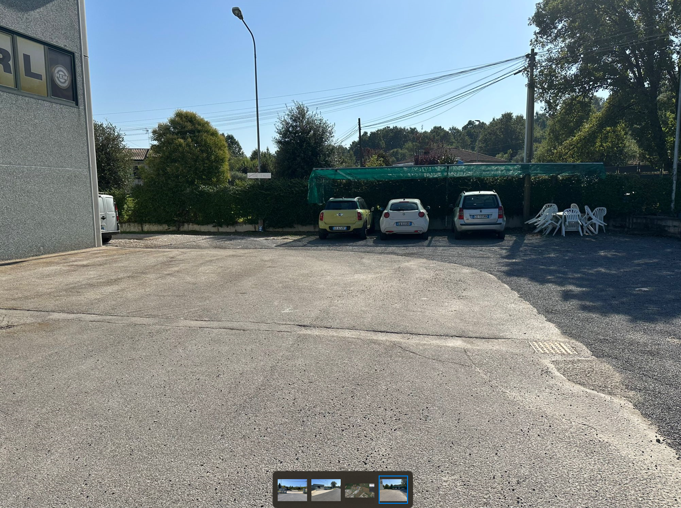
Which way is the truck supposed to park here? Please mark positioning with a square
Is this area covered with gravel or what is it, please?
Width in m?
IS GRAVEL

Slide 2
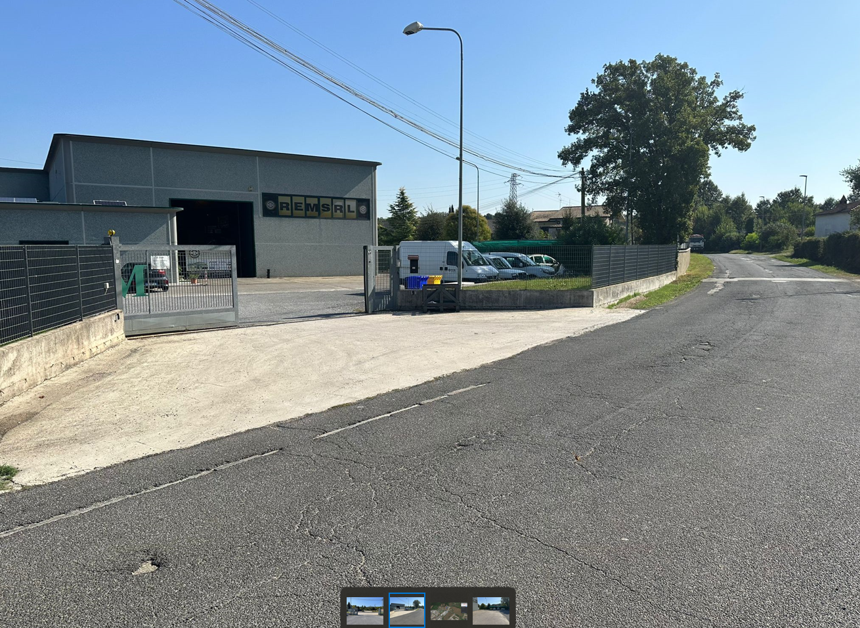
Length of parking area in m?
Truck here possible???
TRUCK HERE : POSSIBLE

Slide 3
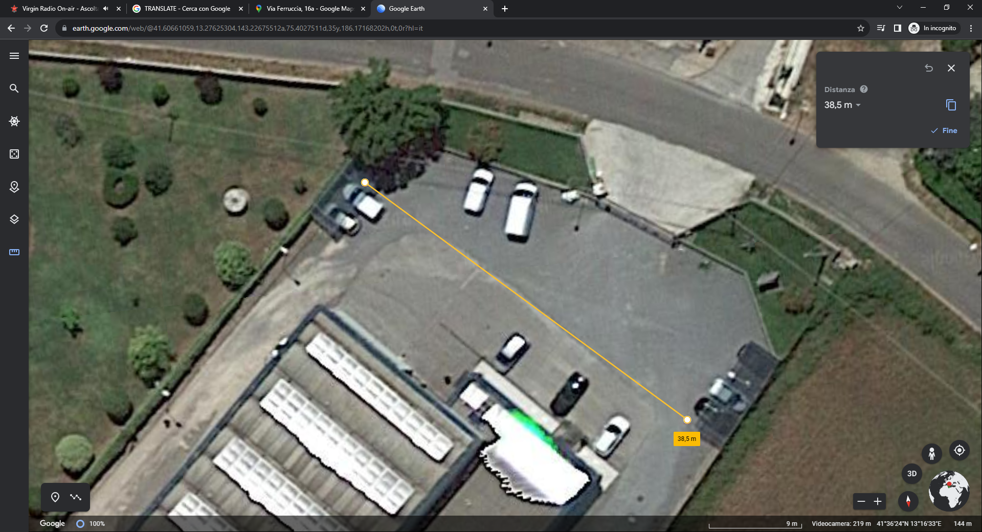

Slide 4
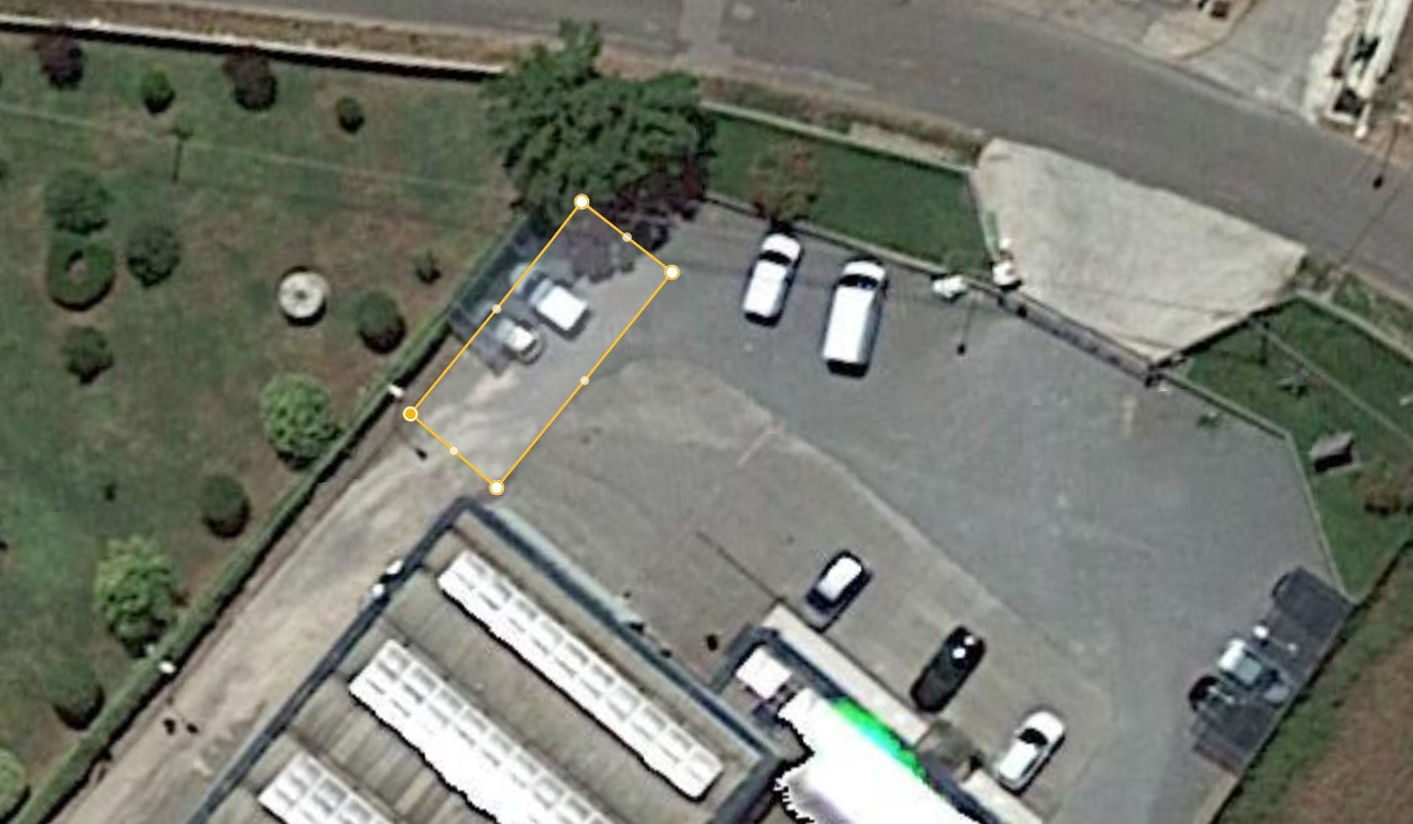
17 MT
4,50 MT.

