Slide 1
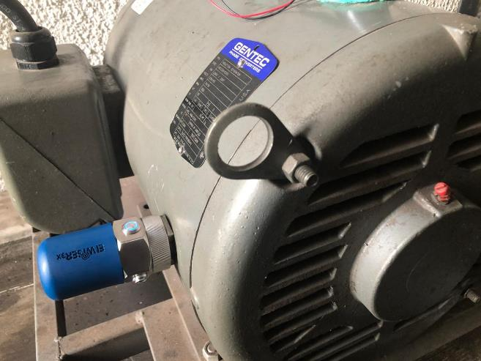
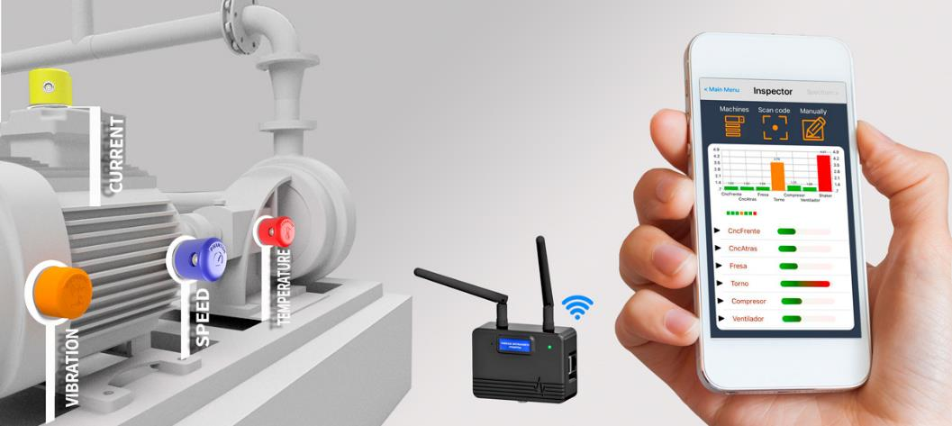
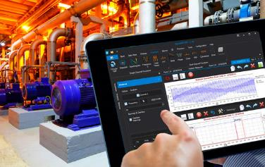
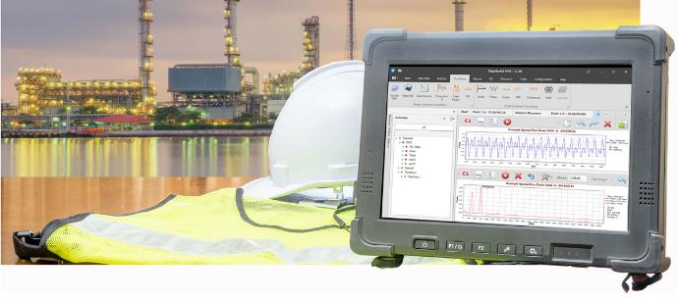
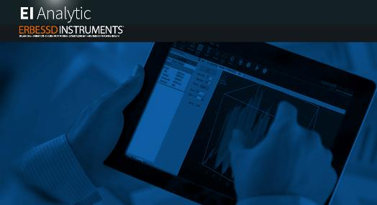

Slide 2
Maintenance is an investment not a cost
Labour
Materials
Contracts
Poor plant reliability and performance
Poor teamwork and
communication
Wasted time, Low yield, Scrap
Late Deliveries, Penalties,
Lost Business
Pollution, Fines
Litigation (legal)

Slide 3
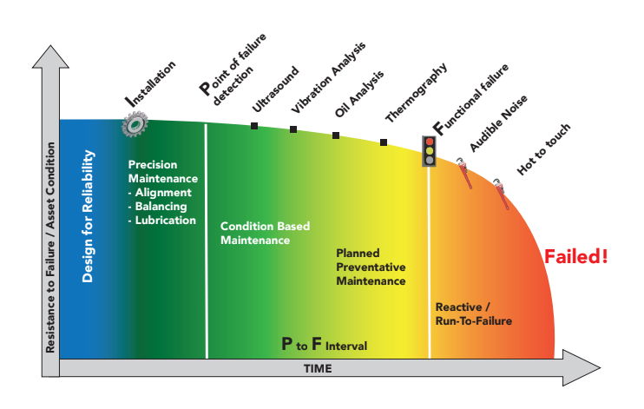
P-F Curve

Slide 4
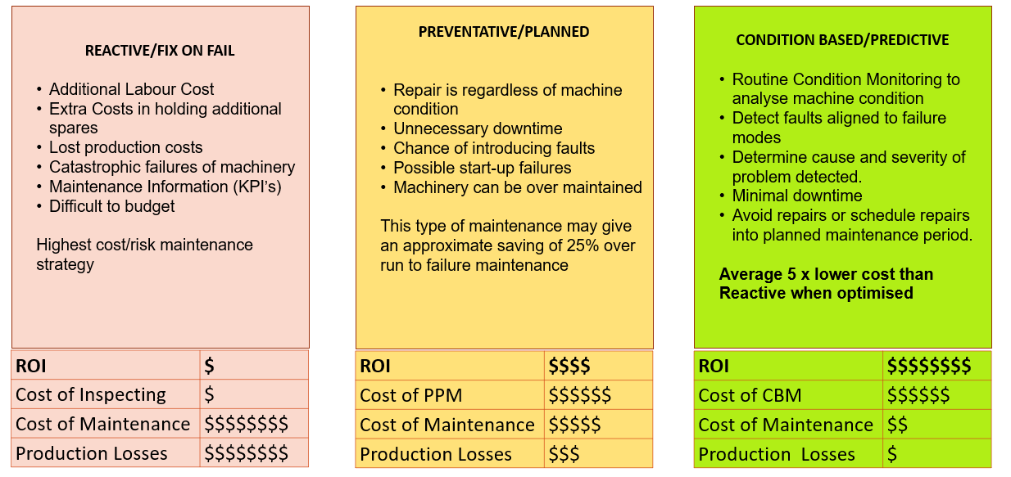
Strategies

Slide 5
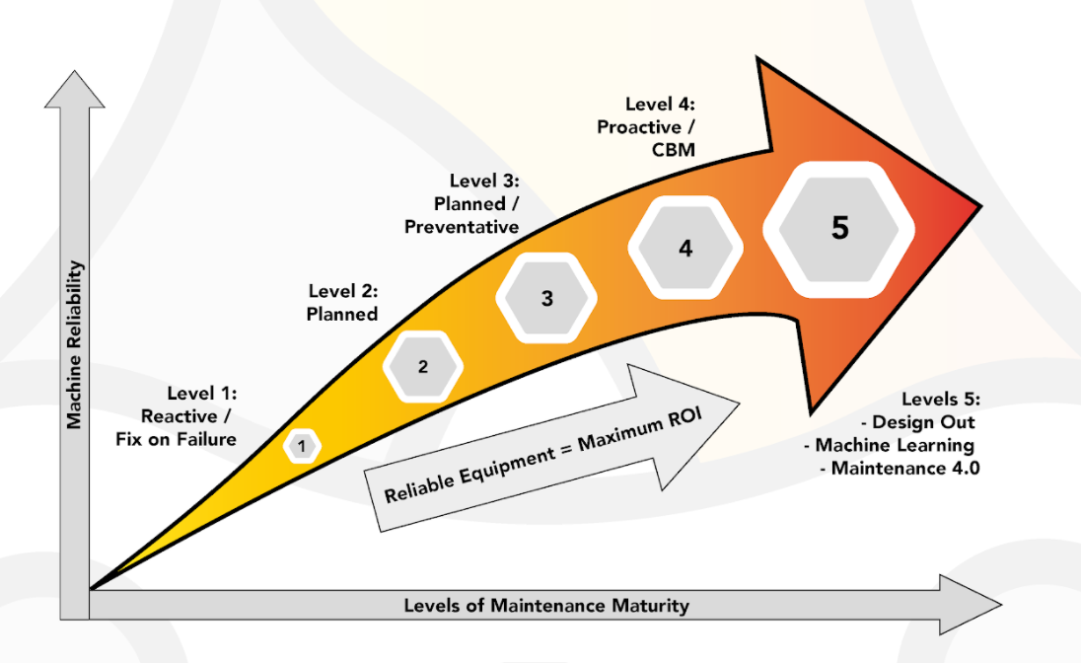
Maintenance Maturity

Slide 6
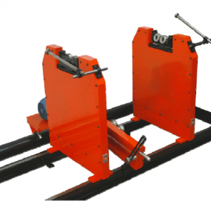
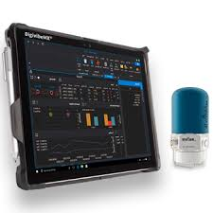
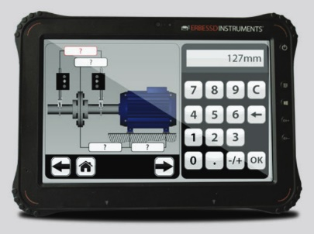
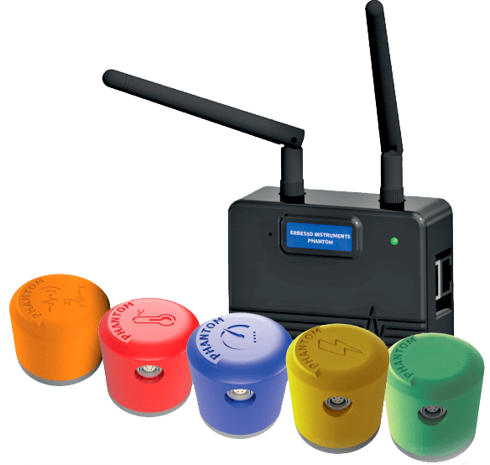
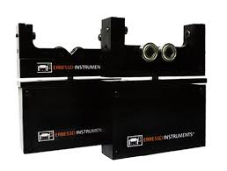
Our Focus
Soft Bearing Dynamic Balancing Machines 30KG-25000KG
Vibration Analysis & Dynamic Balancing
Precision Wireless Laser Shaft Alignment for Horizontal & Vertical Machines
Video Vibration Analysis & Deflection Technology with LiveDial™
Wireless Machine Surveillance
Build Your Own Balancing Machine

Slide 7
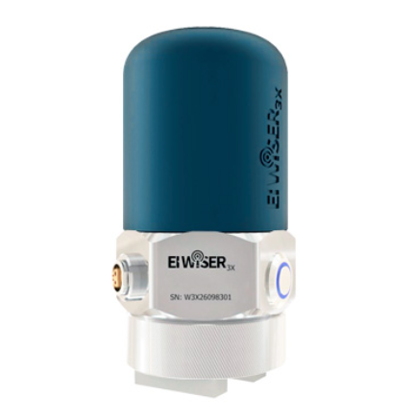
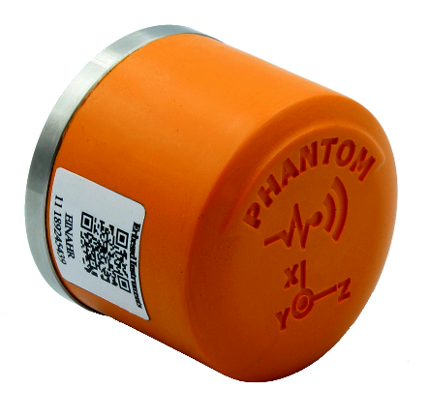
Products for todays discussion
Digivibe Mx
Data
Analysis
Platform
EI Analytic
Cloud
Platform
Phantom
Online
Condition
Monitoring
E-Wiser
Handheld
Data
Collection

Slide 8
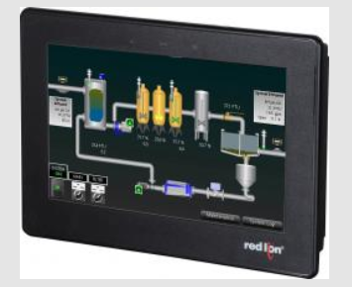
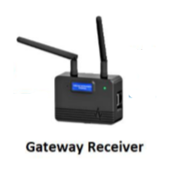
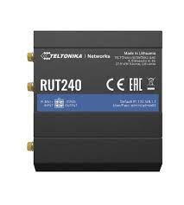
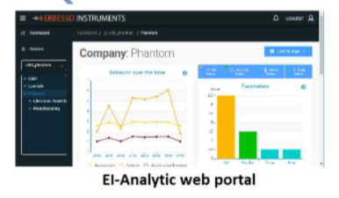
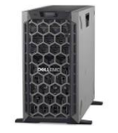
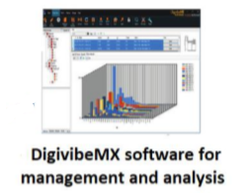
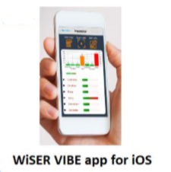
Open Architecture
Piattaforma di Augmented Collaboration
HMI Display Or PLC
DIY Software
Supporto da remoto
Temperatura
OPC
Endpoint to Endpoint
Traininng
Ampère
RMS Data
KNOWLEDGE BASE
RPM
4-20 mA
0-10 V
Ethernet
Internet
WIFI/4G
Internet Web Browser
Bluetooth
Internet
WIFI/4G
Cloud Storage
SQL
All in One V-I-T
RUTER 4G
Local Network
WIFI/
Ethernet
Termocamera
Bluetooth
Local Network
Wi-Fi
Bluetooth
SQL Server or PC
(Vibration only)
Processed Data

Slide 9
Open Architecture
Endpoint to Endpoint
1
n
Internet - Web Browser
Cloud Storage
SQL
Bluetooth
(Vibration only)
Local Network
Wi-Fi
SQL Server or PC
Processed Data

Slide 10
HMI Display Or PLC
Open Architecture
DIY Software
Endpoint to Endpoint
RMS Data
Internet - Web Browser
Internet
WIFI/4G
Cloud Storage
SQL
1
Local Network
WIFI/
Ethernet
n
Bluetooth
(Vibration only)
Local Network
Wi-Fi
SQL Server or PC
Processed Data

Slide 11
HMI Display Or PLC
Open Architecture
DIY Software
Endpoint to Endpoint
RMS Data
Internet - Web Browser
Ethernet
Internet
WIFI/4G
Internet
WIFI/4G
Cloud Storage
SQL
1
Ruter 4g
Local Network
WIFI/
Ethernet
Local Network
WIFI/
Ethernet
n
Bluetooth
(Vibration only)
Local Network
Wi-Fi
SQL Server or PC
Processed Data

Slide 12
HMI Display Or PLC
Open Architecture
Temperatura
DIY Software
Endpoint to Endpoint
Ampère
RMS Data
RPM
Internet - Web Browser
4-20 mA 0-10 V
Bluetooth
WIFI
Cloud Storage
SQL
All in One V-I-T
Local Network
WIFI/
Ethernet
Local Network
WIFI/
Ethernet
Termocamera
Bluetooth
Local Network
Wi-Fi
Bluetooth
SQL Server or PC
(Vibration only)
Processed Data

Slide 13
HMI Display Or PLC
Open Architecture
Temperatura
DIY Software
Endpoint to Endpoint
Ampère
RMS Data
RPM
Internet - Web Browser
Ethernet
Internet
WIFI/4G
Internet
WIFI/4G
4-20 mA 0-10 V
Bluetooth
Cloud Storage
SQL
All in One V-I-T
Ruter 4g
Local Network
WIFI/
Ethernet
Local Network
WIFI/
Ethernet
Termocamera
Bluetooth
Local Network
Wi-Fi
Bluetooth
SQL Server or PC
(Vibration only)
Processed Data

Slide 14
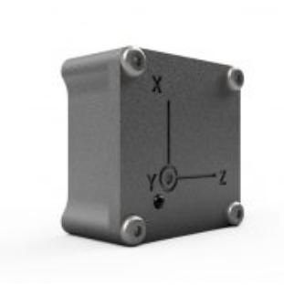
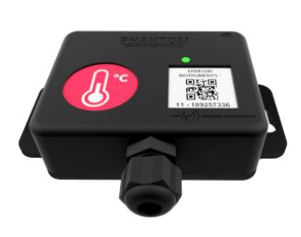
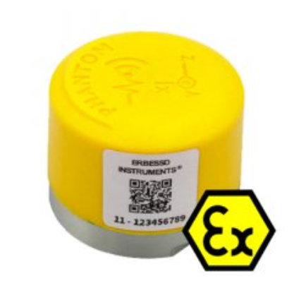
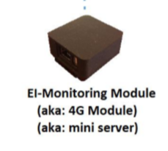
HMI Display Or PLC
DIY Software
DIY Software
Endpoint to Endpoint
RMS Data
Phantom Mini
Phantom Atex
GP8
4-20mA
Speed
Amperage
Temperature
Internet
WIFI/4G
Cloud Storage
SQL
Difficulty & level of Programming required
Modbus
The Phantom Bluetooth gateway or DigivibeMX software can act as a Modbus TCP server.
Allowing automation teams to gather data to their own systems (PLC’s or Scada for example)
Endpoint to Endpoint
Using Postman we have a REST API available for Cloud to cloud integrations
DIY Software
Completely bypass Erbessd software
Client will be required to build their own analysis platform and analysis tools
SDK available in multiple programming languages contact us for more information

Slide 15
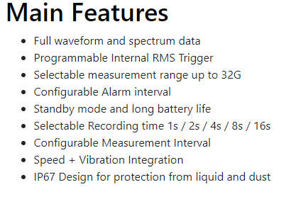
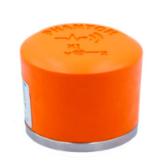
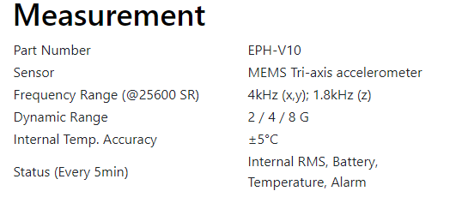
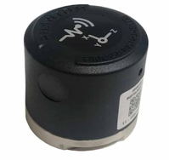
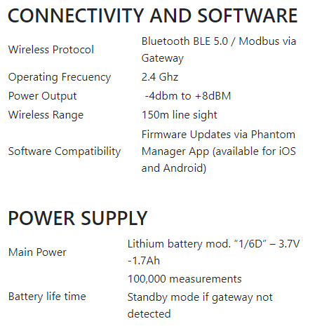
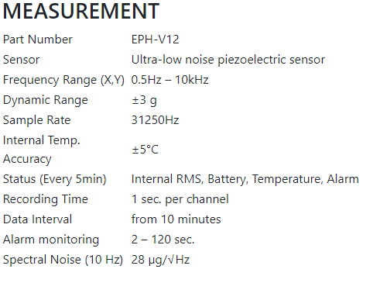
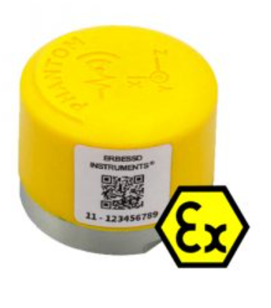
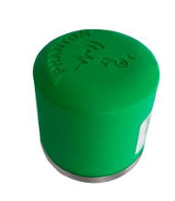
Accelerometers
High Range
High Sensitivity
High Range –ATEX
ATEX Class II Certification:
Ex ic IIC T6 Gc X, &, Ex icIII DC X
Atex version only, the battery is neither rechargeable nor replaceable
Ultra Low Noise

Slide 16
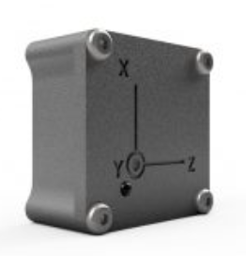
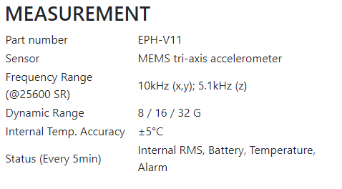
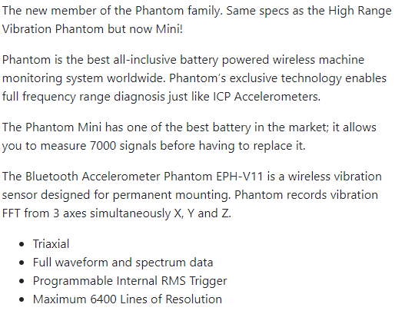
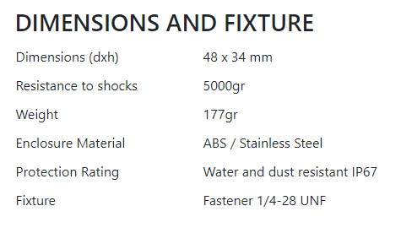
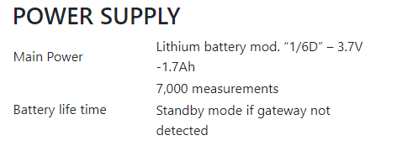
Accelerometers
Phantom Mini

Slide 17
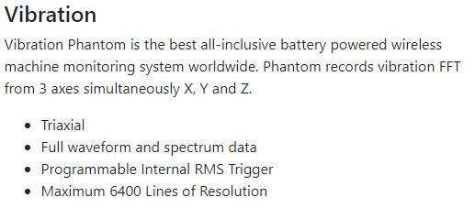
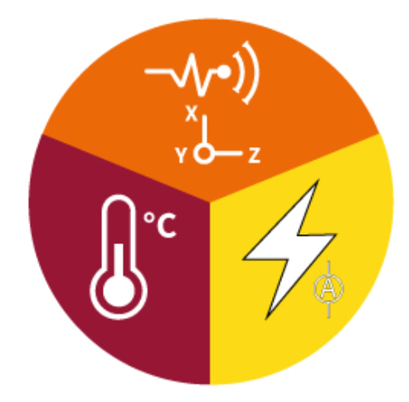
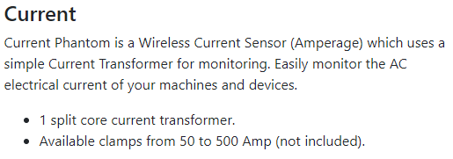
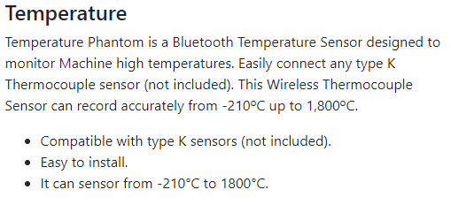
Accelerometers
Vibration Current Temperature Sensor All In One / Phantom All Purpose

Slide 18
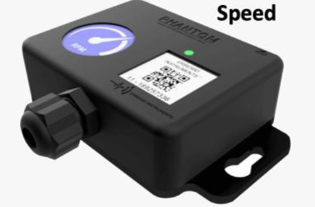
Time Of Day
Specific time of the day
Used to trigger multiple sensors at the same time. Max of 7 at the same time.
Auto Delete
Levels below a set threshold can be discredited
Set Interval
Maximum every 10mins
(full time wave form every 10mins)
3-5year battery based on 4 measures per day
Recording Methods
RPM Trigger
RPM is checked very 5mins
Boundary can be set for rpm range and also time in boundary to then trigger a recording
For example
1000-1500 rpm when the machine is operating in this range for longer than 10mins then record vibration
More than one sensor can be linked to one RPM sensor
Set RMS Trigger
RMS level can be used to trigger a recording.
RMS value check maximum is every 30 seconds
Recommended every 5 minutes

Slide 19
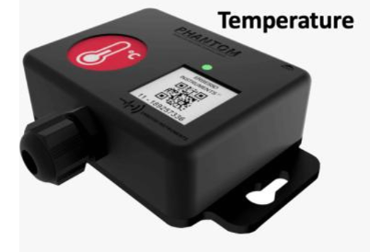
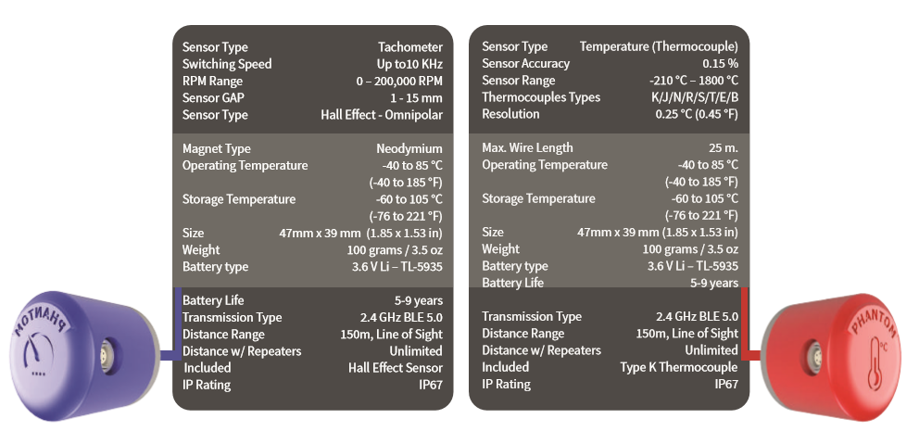
Speed
Temperature
RPM
Using
Hall
Effect
Contact
&
Non
Contact

Slide 20
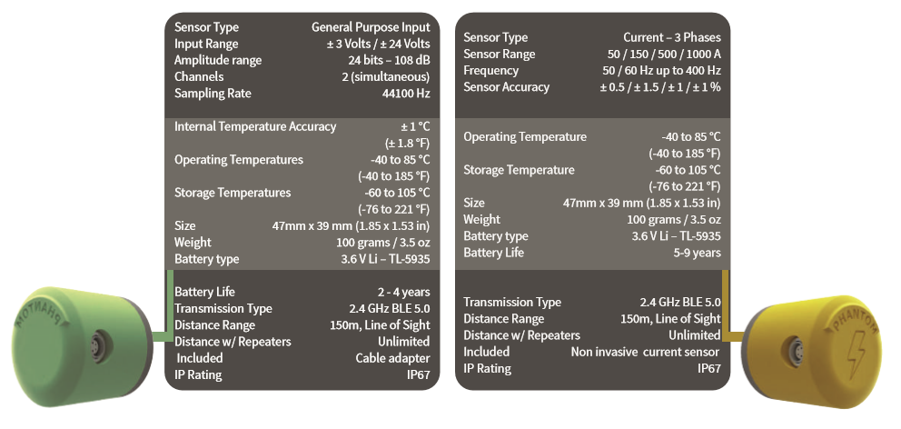
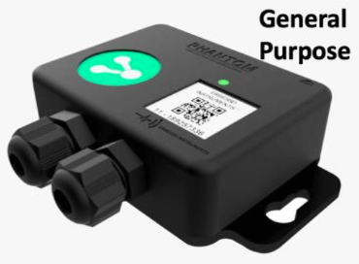
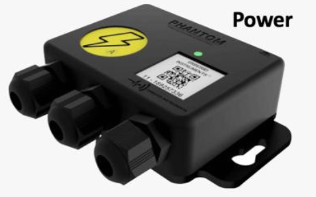
General Purpose
Amperage
4-20mA
&
0-5V

Slide 21
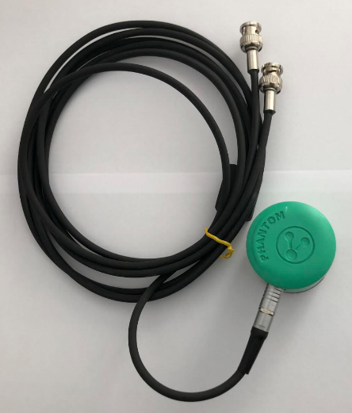
GP8
Utilisation of existing fixed accelerometers on site. Using the Phantom General purpose unit and and Erbessd GP8 - 8 channels of vibration

Slide 22
On the Way
Ready for market end of October

Slide 23
World Class SQL Machine Health Database

Slide 37
REFERENCES

